Slide 1
Assignment #3: Kalah

Slide 2
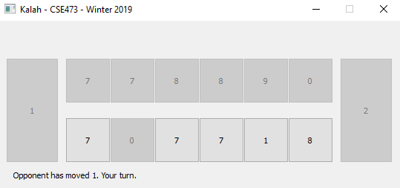
File
main.py (Basic functions for Kalah game, connecting to the server, etc.)
ui.py (GUI interface for the game)
ai.py (Your job: determine next move according to current situation)

Slide 3
ai.py
Class state (storing current stones in each hole and kalah)
Function move (determine your next move, choose a hole from number 0 – 5)
Function minmax (minmax algorithm with alpha-beta pruning)
Note:
Must be minmax algorithm with alpha-beta pruning algorithm! Otherwise you will loss all points!
Don’t change the names of important variables and functions.

Slide 4
Turn In
hw3.zip
ai.py
report.pdf

Slide 5
Report
report describing your implementation (at most 5 pages, 1” margins, 11pt, double-spaced), 8 points:
A brief description of the game: 1 points.
The definition of your heuristic function and its justification. Illustrate how it works with example moves it chose and explain why it chose them in terms of the function: 3 points.
The details of your program design, experiments and results:
How long it takes to make a move at different search depths and specify your CPU speed in the report. Timing restrictions are only for the tournament: 2 points.
How each heuristic function you designed affect the performance, e.g., the algorithm with this heuristic function vs the algorithm without this heuristic function: 2 points.

Slide 6
Experiments and Results
Heuristic functions
$$Heuristic function=F_{1}+F_{2}+F_{3}+F_{4}$$
Function | F1 | +F2 | +F3 | +F4
Baseline | 0 vs 5 | 0 vs 5 | 0 vs 5 | 0 vs 5
Baseline could be a naïve model you built, or previous version of the algorithm, e.g. (F1+F2+F3 vs F1+F2)
Searching time at different depth
Depth | 1 | 2 | 3 | 4
Time | 0s | 0s | 0s | 0s
Note: The search time is at most 1 second during tournament.

Slide 7
Tournaments:
Play-off mode, randomly paired, the winner enter the next round.
Score calculation (Player A vs Player B):
A move first: a : b
B move first: c : d
Final scores: (a + c : b + d)
Illegal move or searching exceeds 1 sec will down your score to zero.
The players after xxx round will receive bonus points!

Slide 8
Note
The game server can be only connected when you are using Campus Internet. If you want to debug outside of campus, using VPN or commenting line #43 at main.py.

